Slide 1
Financial Analytics

Slide 2
Objectives
Top 10 companies with highest market capital
Top 10 companies with highest Quarterly Sales
Bottom 10 companies with lowest market capital
Bottom 10 companies with lowest Quarterly Sales

Slide 3
The Process
Data collection
Data cleaning
Data Analysis
Insights

Slide 4
Data Collection
Data collected from Csv file named “Financial_data_analysis.csv”
The csv file has the data of Top 500 companies
Market capital and quarterly sales

Slide 5
Data Cleaning
Remove the S.No. columns as it not required for analysis
Used python to deal with null values
Removed outliers using python

Slide 6
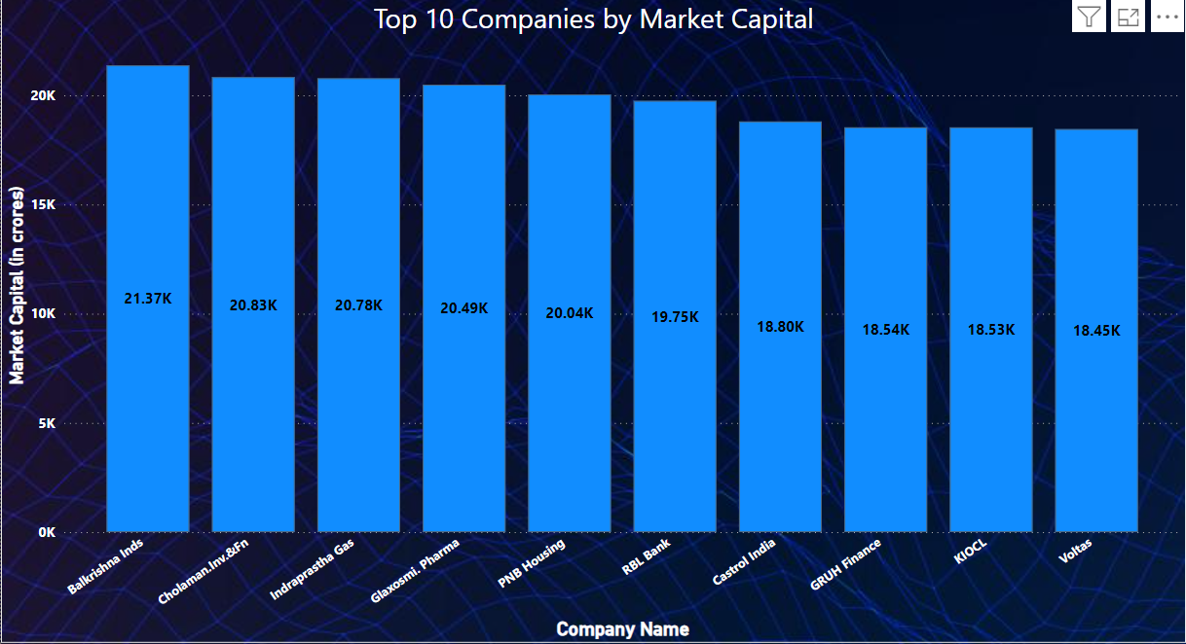
Data Analysis
Balkrishna Inds has the highest market capital at 21.37k Crore

Slide 7
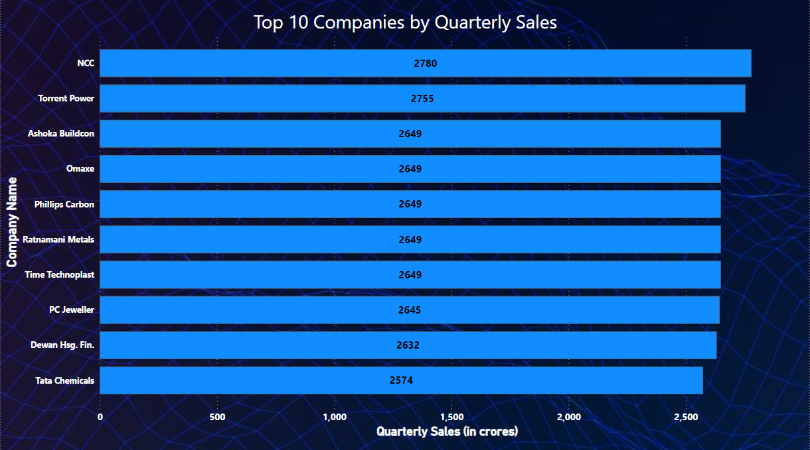
Data Analysis
NCC has the highest Quarterly Sales at 2780 Crores

Slide 8
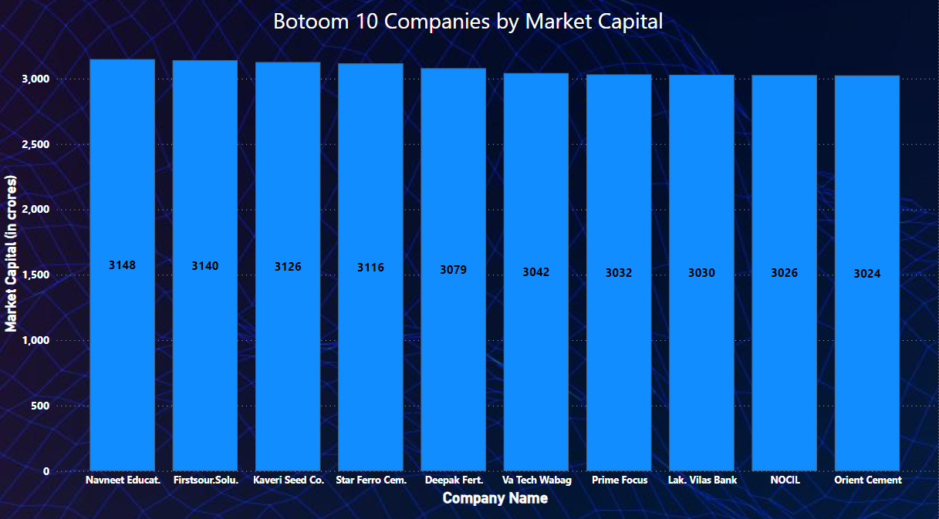
Data Analysis
Orient Cement has the lowest Market Capital at 3024 Crores

Slide 9
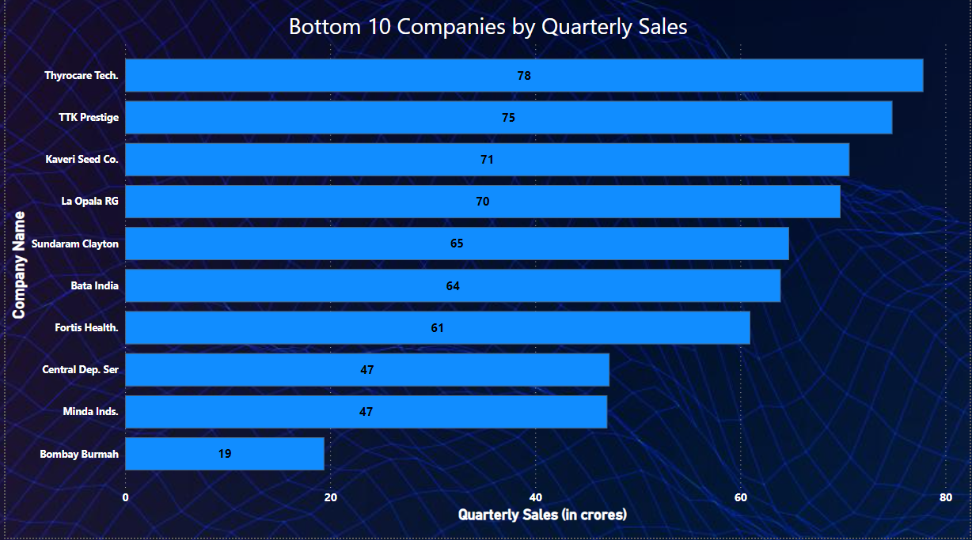
Data Analysis
Bombay Burmah has the lowest Quarterly Sales at 19 Crores only

Slide 10
Insights
Balkrishna Industries and Cholaman Investment and Finance has the Highest Market Capital at 21.37K Crores and 20.83K Crores respectively which is 606.6 % more than Orient Cement which has the lowest Market Capital at 3024 Crores.
NCC has the Highest Quarterly Sales at 2780 Crores which is 14531.5 % more than Bombay Burmah which has the lowest Quarterly Sales of 19 Crores

Slide 11
Thank You

